Slide 1


Cloud Computing

Slide 2
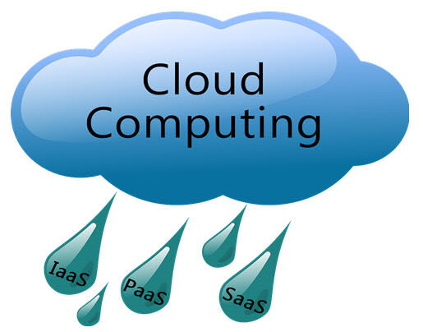

Slide 3
Module Outline
Fundamental concepts of Distributed Systems
Cluster Computing
Grid Computing
Cloud Computing
Mobile Computing

Slide 4
What is computing?
Computing is the process of using computer technology to complete a given goal-oriented task.
Computing may encompass the design and development of software and hardware systems for a broad range of purposes - often structuring, processing and managing any kind of information
to aid in the pursuit of scientific studies, making intelligent systems, and creating and using different media for entertainment and communication.
the use of a computer to process data or perform calculations.
It has scientific, engineering, mathematical, technological and social aspects.
The list is virtually endless, and the possibilities are vast

Slide 5
What is Distributed sysem?
A distributed system, also known as distributed computing, is a system with multiple components located on different machines that communicate and coordinate actions in order to appear as a single coherent system to the end-user.
Example -
Telecommunication networks: Telephone networks and Cellular networks.
A massively multiplayer online game (MMOG, or more commonly, MMO) is an online game with large numbers of players, often hundreds or thousands
World wide web

Slide 6
Distributed Systems : A brief introduction
A collection of independent computers that appears to its users as a single coherent system.
Features:
No shared memory
Message-based communication
Each runs its own local OS
Heterogeneity
Ideal: to present a single-system image:
The distributed system “looks like” a single computer rather than a collection of separate computers.

Slide 7
Distributed Systems : A brief introduction
Distributed system: the hardware and software of a collection of independent computers that cooperate to realize some functionality
–usually, individual parts cannot realize that functionality just by themselves
–may be serving a user (...ultimately)

Slide 8
Centralized System Characteristics On-Cs-Ra-S-P-P
One component with Non-autonomous parts
Components shared by users all the time
All Resources accessible
Software runs in a single process
Single point of control
Single point of failure

Slide 9
Distributed System Characteristics opposite of Centralised..
Multiple autonomous components
Components are not shared by all users
Resources may not be accessible
Software runs in concurrent processes on different processors
Multiple points of control
Multiple points of failure

Slide 10
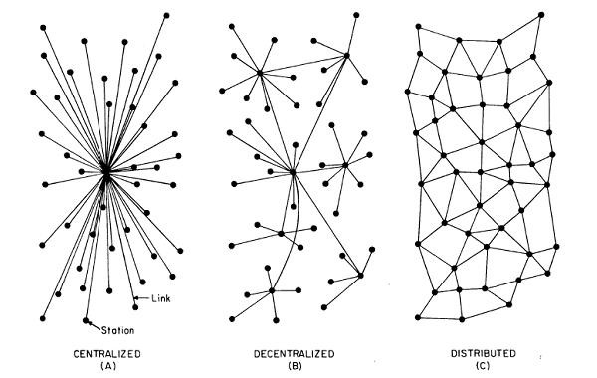

Slide 11
Distributed System Characteristics (SEAM)
To present a Single-system image:
Hide internal organization, communication details
Provide uniform interface
Easily Expandable
Adding new computers is hidden from users
Continuous Availability
Failures in one component can be covered by other components
Supported by Middleware

Slide 12
Advantages of Distributed System over Centralized System(SIRI)
Speed - When used to implement parallel processing where only goal is to achieve maximum speed on a single problem, distributed systems can achieve very high speed as compared to the centralized ones.
Inherent Distribution- Another reason for building a distributed system is that some applications are inherently distributed. Banking, Airline reservation etc. are examples of the applications that are inherently distributed . When all the branches of a bank are connected, we have a commercial distributed system.

Slide 13
Contd ..
Reliability- By distributing the workload over many machines, a single chip failure will bring down at most one machine, leaving the rest intact.
For critical applications, such as control of nuclear reactors or aircraft, using a distributed system to achieve high reliability may be a dominant consideration
Incremental Growth- Often a company will buy a mainframe with the intention of doing all its work on it.
If the company prospers and the workload grows, at a certain point the mainframe will no longer be adequate.

Slide 14
Contd ..
The only solutions are to either replace the mainframe with a larger one (if it exists), or add a second mainframe. Both of these can cause management difficulties with the company's operations.
In contrast, with a distributed system, it may be possible to simply add more processors to the system, thus allowing it to expand gradually as the need arises.

Slide 15
Disadvantages of Distributed System
Software: difficult to develop software for distributed systems
Control :Distribution of control
Network: saturation, lossy transmissions
Security: easy access also applies to secret data
Hard to detect faults
Administration issues

Slide 16
What is Cluster Computing?
A computer cluster is a group of linked computers, working together closely so that in many respects they form a single computer.
The components of a cluster are commonly, but not always, connected to each other through fast local area networks.
Clusters are usually deployed to improve performance and/or availability over that provided by a single computer, while typically being much more cost-effective than single computers of comparable speed.
APP
APP
…
APP
Cluster Middle ware
High Speed Local Network
CPU
CPU
…
CPU
Cluster

Slide 17
What is Cluster Computing?
Cluster consists of :
Nodes(master + computing)
Network
OS
Cluster middleware: Middleware such as MPI (Message Passing Interface) which permits compute clustering programs to be portable to a wide variety of clusters
A cluster has two types of computers - a master computer, and node computers.
When a large problem or set of data is given to a cluster, the master computer first runs a program that breaks the problem into small discrete pieces; it then sends a piece to each node to compute. As nodes finish their tasks, the master computer continually sends more pieces to them until the entire problem has been computed.

Slide 18
Types of cluster computing
High Availability (HA) and failover clusters –
These models are built to provide an availability of services and resources in an uninterrupted manner through the use of implicit redundancy to the system.
If a cluster node fails (failover), applications or services may be available in another node.
These types are used to cluster data base of critical missions, mail, file and application servers.
Load balancing (LB) –
This model distributes incoming traffic or requests for resources from nodes that run the same programs between machines that make up the cluster.
If a node fails, the requests are redistributed among the nodes available.
This type of solution is usually used for Web servers .

Slide 19
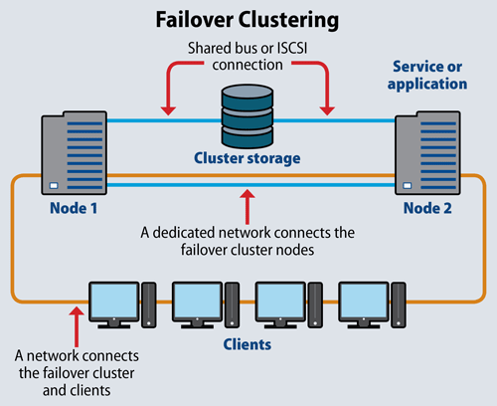
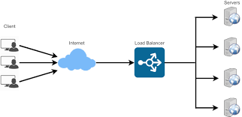
Load Balancing

Slide 20
Types of cluster computing
HA &LB combination –
As its name says, it combines the features of both types of cluster, thereby increasing the availability and scalability of services and resources.
This type of cluster configuration is widely used in web, email, news, or ftp servers.

Slide 21
Cluster Computing
Advantages
Increasing speed – better performance
optimized resources utilization
Can execute Large applications
Disadvantages
Complex programming models
Difficult for debug and development

Slide 22
Grid Computing
Grid Computing was first coined in 1990s by Cart Kesselman & Ian Foster and defined as –
“Grid computing is coordinated resource sharing and problem solving in dynamic, multi-institutional virtual organizations.”

Slide 23
Grid Computing
Computing grids are conceptually and logically like electrical grids. In an electrical grid, wall outlet allow us to connect to an infrastructure of resources which generate and distribute the electricity. Likewise, in the IT industry, grid computing uses middleware to coordinate distinct IT resources over the network, allowing them to function and work as a virtual whole.
The goal of a computing grid , like that of a electrical grid, is to provide users with access to the resources they need, when they need them and to provide remote access to IT assets and aggregating processing power.
Grid provides a series of distributed computing resources via LAN or WAN to the terminal user’s application, as if he is using a super virtual computer.

Slide 24
Grid computing is the integration of computer resources for achieving similar objective.
Grids are frequently created with middleware software libraries of a common grid.
Grids are a type of dispersed computing system, whereas a virtualized super computer is made from various networked.
Grids focus on two different but associated objectives—supplying isolated access to IT resources and building up processing control.
The grid is a technology which controls two factors—allocation and trust.

Slide 25
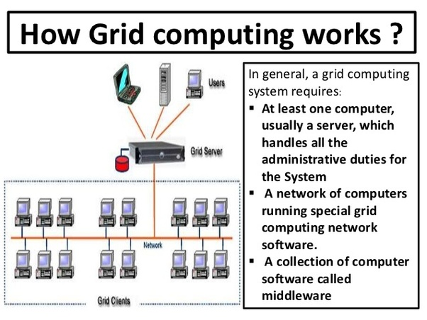

Slide 26
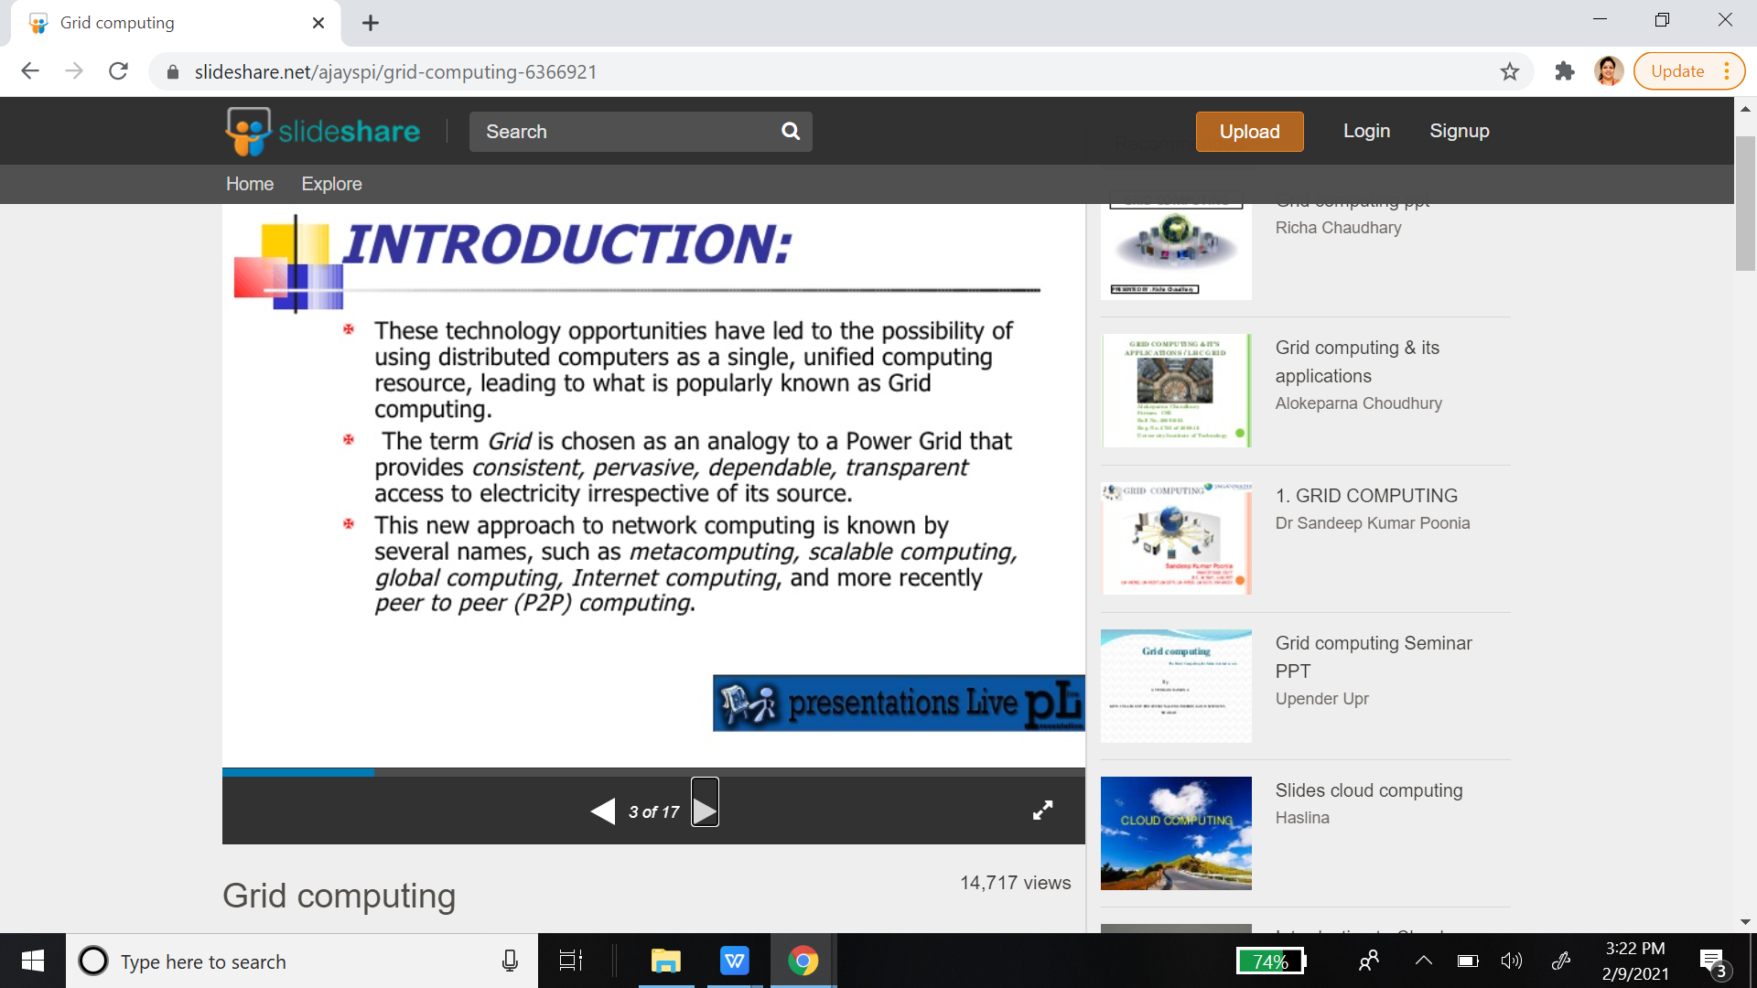

Slide 27
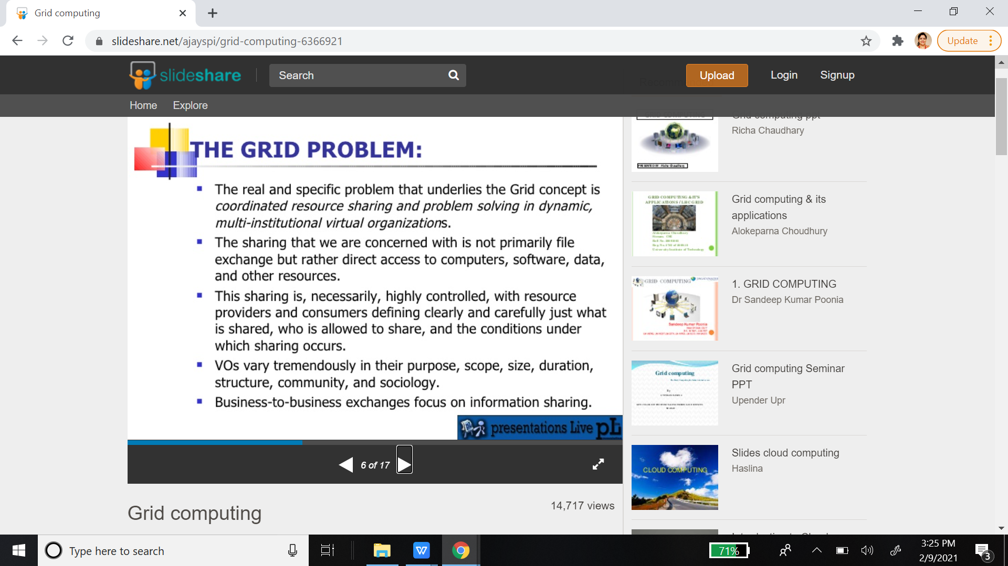

Slide 28
Grid Computing is a subset of distributed computing, where a virtual super computer comprises of machines on a network connected by some bus, mostly Ethernet or sometimes the Internet.

Slide 29
Components in Grid
A Grid computing network mainly consists of these three types of machines
Control Node:
A computer, usually a server or a group of servers which administrates the whole network and keeps the account of the resources in the network pool.
Provider:
The computer which contributes it’s resources in the network resource pool.
User:
The computer that uses the resources on the network.
For controlling the network and it’s resources a software/networking protocol is used generaly known as Middleware. This is responsible for administrating the network and the control nodes are merely it’s executors. As a grid computing system should use only unused resources of a computer, it is the job of the control node that any provider is not overloaded with tasks.

Slide 30
Another job of the middleware is to authorize any process that is being executed on the network. In a grid computing system, a provider gives permission to the user to run anything on it’s computer, hence it is a huge security threat for the network. Hence a middleware should ensure that there is no unwanted task being executed on the network.

Slide 31
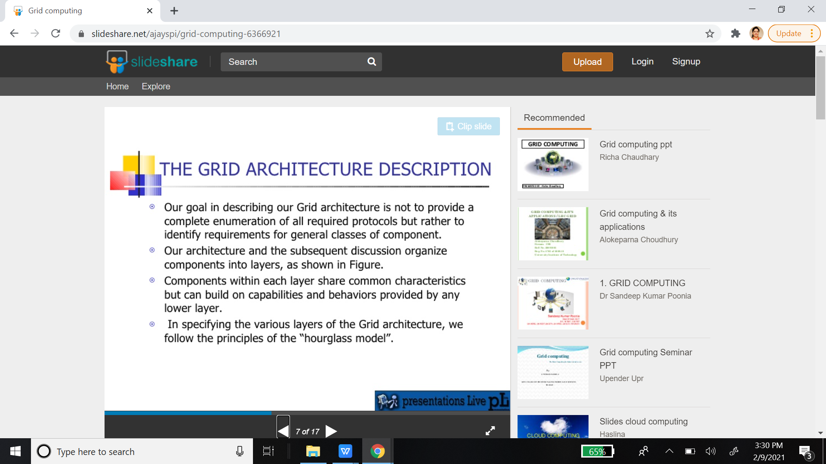

Slide 32
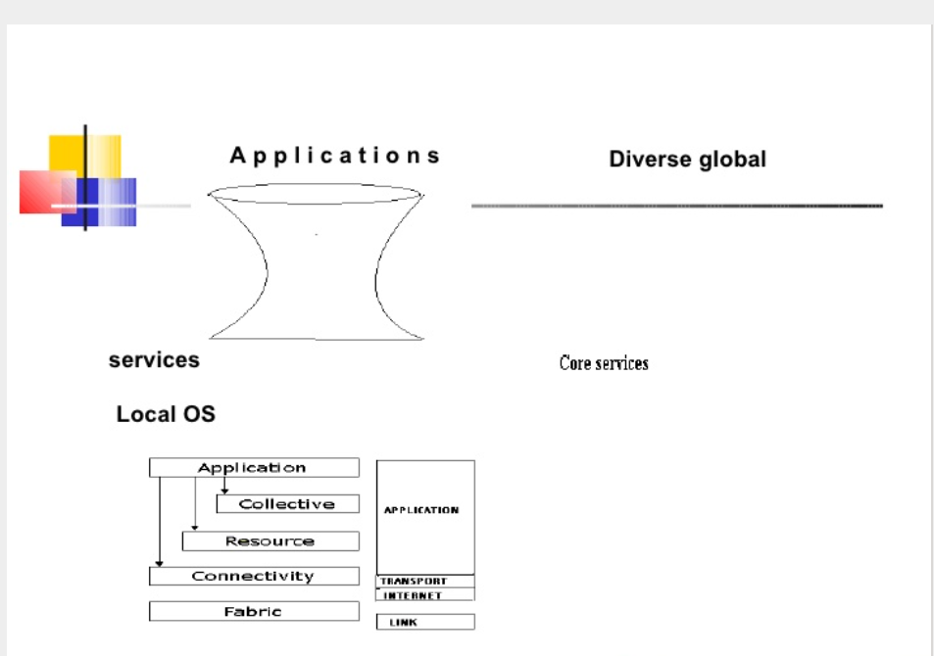

Slide 33
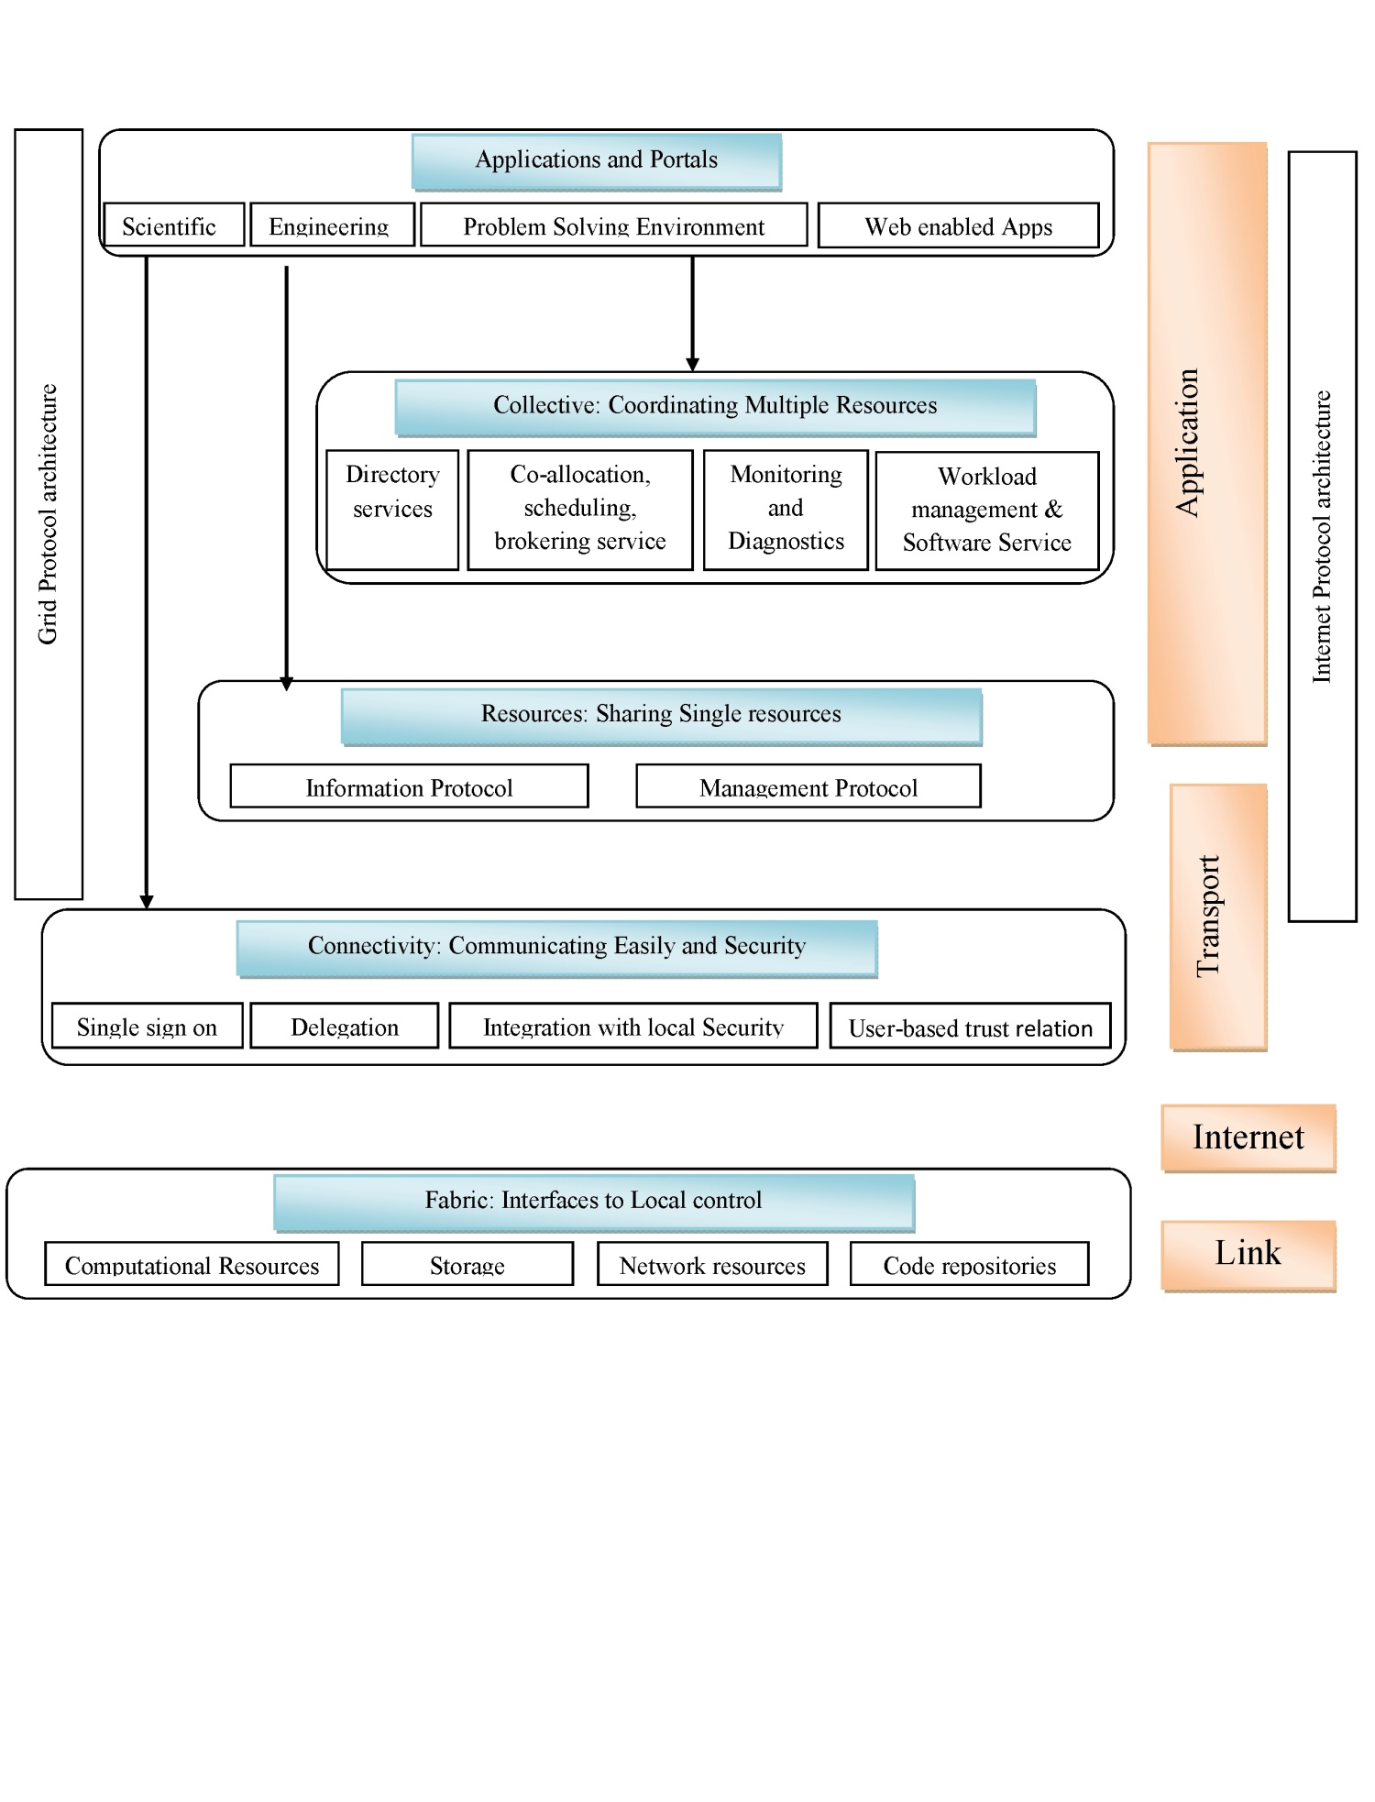
Architecture of Grid

Slide 34
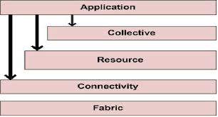
Grid Computing
Layers of Grid System architecture are as follows:
(i)Fabric Layer: Lowest layer
It comprises geographically distributed and sharable resources such as storage devices, computing devices, high bandwidth networks and scientific instruments, etc.
These resources are accessible from anywhere in the internet.
(ii)Connectivity Layer:
It provides an easy and secure access to the resources through some standardized protocols.
The authentication protocols are used to provide proper verification of users and resources.
The communication protocols provide a mechanism for transmission of data between the fabric and the resource layer.

Slide 35
Cont ...
(iii)Resource Layer:
It specifies the necessary protocols to operate among shared resources.
It is primarily built upon the communication and authentication protocols of connectivity layer.
It defines the APIs (Application Program Interfaces) and SDK (Software Development Kit) to make secure the initiation, accounting, negotiation, controlling and monitoring of resources.
(iv)Collective Layer:
It is used for common functional utilities.
The operations such as collaboration among the shared resources are performed in this layer.
It provides services like brokering, monitoring, scheduling, discovery, replication and co-allocation etc.

Slide 36
Grid Computing
(v)Application Layer:
This layer offers communication interfaces to the users and the administrators for interacting with the Grid.

Slide 37
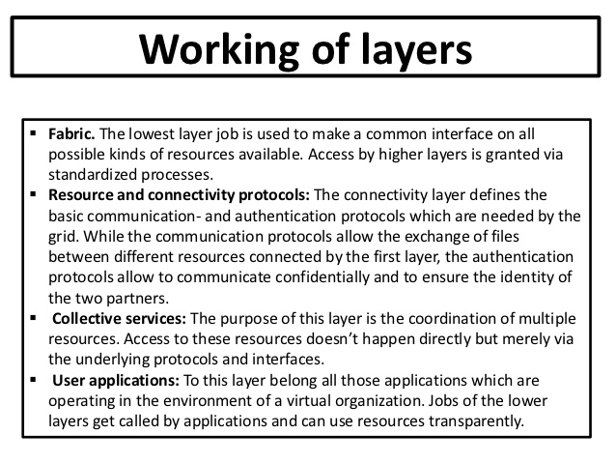

Slide 38
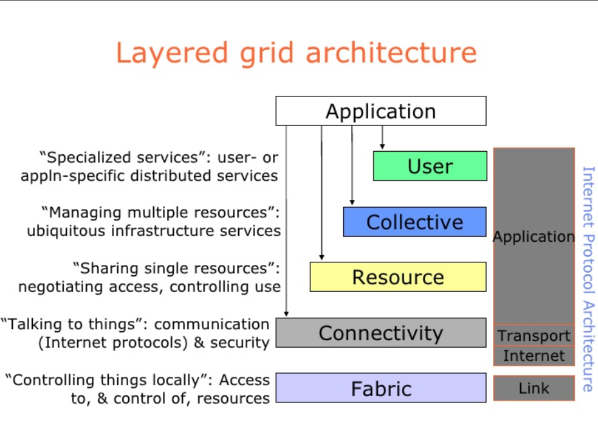

Slide 39
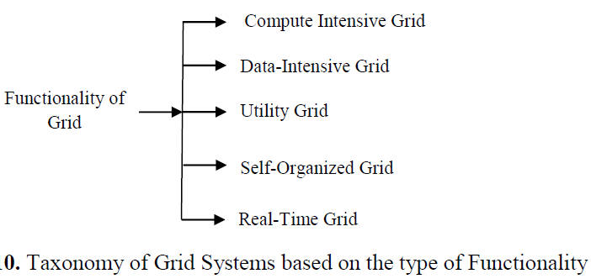
Types of Grid Systems

Slide 40
Types of Grid Systems
Compute Intensive:
Major functionality of this Grid is to offer powerful CPU resources, whereas other characteristics are trivial.
It intends to provide aggregated CPU cycles of several resources for fulfilling computational need of a particular application.
Data-Intensive Grid:
It offers large storage space for data discovery, data management and data processing.
Utility Grid:
It pools dynamically available resources to match the requirements of the applications.
This enables the Utility Grid to provide services that cannot be provided by any single machine.

Slide 41
Cont ...
Self-Organized Grid:
Grid management is extremely challenging due to its complex dynamic environment.
However, Self-Organized Grid includes some intelligence embedded into its infrastructure to automate its control, organization, and monitoring procedure.
It can heal itself in changing and uncertain environments for maximizing reliability and resource utilization.
Real Time Grid:
Traditional Grid could not support certain requirements of many real time applications.
Technological advancement with increasing number of real time applications initiated the emergence infrastructure that can deal with the rich variety of real time interactions between the users and the applications through virtual workspace.
Therefore, Grids that support Real time applications such as disaster management, e-healthcare, e-learning etc. can be termed as Real-Time Grid.

Slide 42
Examples
a) Health
World Community Grid
World Community Grid’s mission is to create the largest public computing grid benefiting humanity, which is funded and operated by IBM. Using the idle time of computers around the world, World Community Grid’s research projects have analyzed aspects of the human genome, HIV, dengue, muscular dystrophy, and cancer.
B) Engineering Design
Analysis of real-time data to find a particular pattern.
• Experiment modeling to create new designs.
• Verifying existing models for accuracy using simulation activities.
C) Grid Computing in Government
C-DAC launched the Indian National Grid Computing Initiative - GARUDA, with a vision to facilitate solutions to scientific, engineering and socio-economic development. GARUDA is a collaboration of scientific and technological researchers on a nation wide grid comprising of computational nodes, mass storage and scientific instruments. The aim is to provide the technological advances required to enable data and compute intensive science and engineering applications for the 21st Century.
D) Education, Science and beyond
SETI (Search for Extraterrestrial Intelligence) @Home project
SETI@home is a scientific experiment that uses Internet-connected computers in the Search for Extraterrestrial Intelligence (SETI). You can participate by running a free program that downloads and analyzes radio telescope data.
Education - e-learning
E) Grid Computing in the Movie Industry
Many films can’t be made without the use of grid computing not only because of special effects but also because of the fact that grid computing enables faster production of a film.
Grid computing is an enhancement tool for the studios.

Slide 43
Mobile Computing
Mobile Computing is a technology that allows transmission of data, voice and video via a computer or any other wireless enabled device without having to be connected to a fixed physical link. The main concept involves −
Mobile communication
Mobile hardware
Mobile software

Slide 44
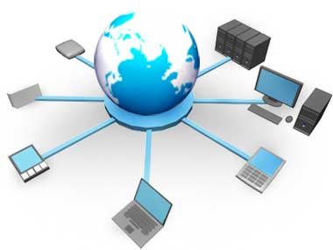
Mobile Computing
The mobile communication in this case, refers to the infrastructure put in place to ensure that seamless and reliable communication goes on. These would include devices such as protocols, services, bandwidth, and portals necessary to facilitate and support the stated services. The data format is also defined at this stage.

Slide 45
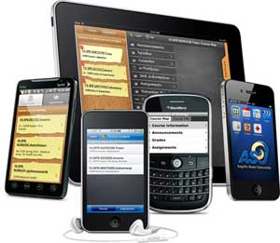

Mobile Computing
Mobile Hardware
Mobile hardware includes mobile devices or device components that receive or access the service of mobility. They would range from portable laptops, smartphones, tablet Pc's, Personal Digital Assistants.
Mobile software
Mobile software is the actual program that runs on the mobile hardware. It deals with the characteristics and requirements of mobile applications. This is the engine of the mobile device. In other terms, it is the operating system of the appliance. It's the essential component that operates the mobile device.

Slide 46
What is Cloud Computing?
Cloud Computing is a general term used to describe a new class of network based computing that takes place over the Internet,
basically a step on from Utility Computing
a collection/group of integrated and networked hardware, software and Internet infrastructure (called a platform).
Using the Internet for communication and transport provides hardware, software and networking services to clients

Slide 47
Contd..
These platforms hide the complexity and details of the underlying infrastructure from users and applications by providing very simple graphical interface or API
The platform provides on demand services, that are always on, anywhere, anytime and any place.
Pay for use
Scalable as needed
-scale up and down in capacity and functionalities
The hardware and software services are available to general public, enterprises, corporations and businesses markets

Slide 48
Difference between cluster and cloud computing (SCHOL)
Spanning area -Cluster is a group of computers connected by a local area network (LAN), whereas cloud and grid are more wide scale and can be geographically distributed.
Coupling - cluster is tightly coupled, whereas a grid or a cloud is loosely coupled.
Homogeneity -clusters are made up of machines with similar hardware, whereas clouds and grids are made up of machines with possibly very different hardware configurations.
Ownership: A grid is a collection of computers which is owned by multiple parties in multiple locations. Whereas a cloud is a collection of computers usually owned by a single party.
Load distribution: In cluster the load is distributed among all nodes but in case of Cloud, the resources are allocated as per the request. The whole data center is not occupied by one job.

Slide 49
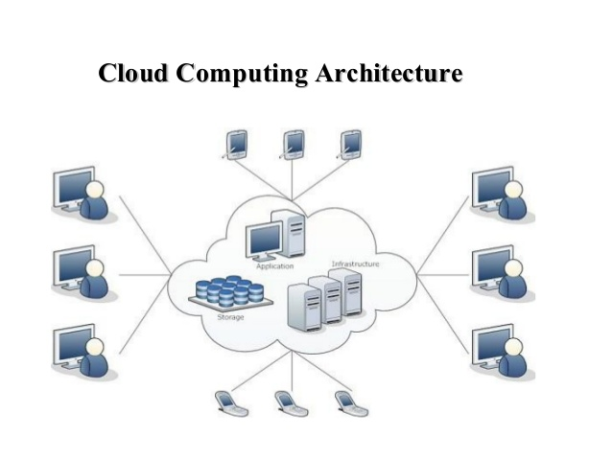
What is Cloud Computing?
Cloud computing is an umbrella term used to refer to Internet based development and services

Slide 50
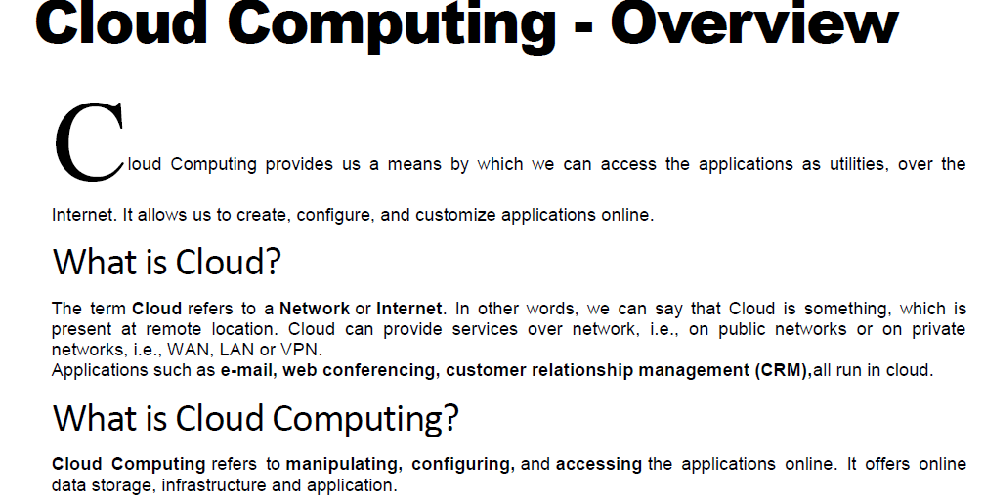

Slide 51
We need not to install a piece of software on our local PC and this is how the cloud computing overcomes platform dependency issues. Hence, the Cloud Computing is making our business application mobile and collaborative.

Slide 52
Basic Concepts
There are certain services and models working behind the scene making the cloud computing feasible and accessible to end users. Following are the working models for cloud computing:
Deployment Models
Service Models
DEPLOYMENT MODELS
Deployment models define the type of access to the cloud, i.e., how the cloud is located? Cloud can have any of the four types of access: Public, Private, Hybrid and Community

Slide 53
Deployment Models
The Public Cloud allows systems and services to be easily accessible to the general public. Public cloud may be less secure because of its openness, e.g., e-mail.
The Private Cloud allows systems and services to be accessible within an organization. It offers increased security because of its private nature.
Cummunity Cloud -The Community Cloud allows systems and services to be accessible by group of organizations.
The Hybrid Cloud -is mixture of public and private cloud. However, the critical activities are performed using private cloud while the non-critical activities are performed using public cloud.

Slide 54
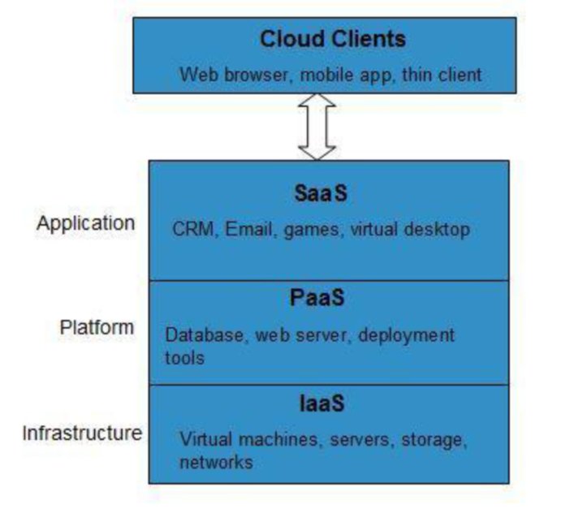
Service Models
INFRASTRUCTURE AS A SERVICE (IAAS)
IaaS provides access to fundamental resources such as physical machines, virtual machines, virtual storage, etc.
PLATFORM AS A SERVICE (PAAS)
PaaS provides the runtime environment for applications, development & deployment tools, etc.
SOFTWARE AS A SERVICE (SAAS)
SaaS model allows to use software applications as a service to end users

Slide 55
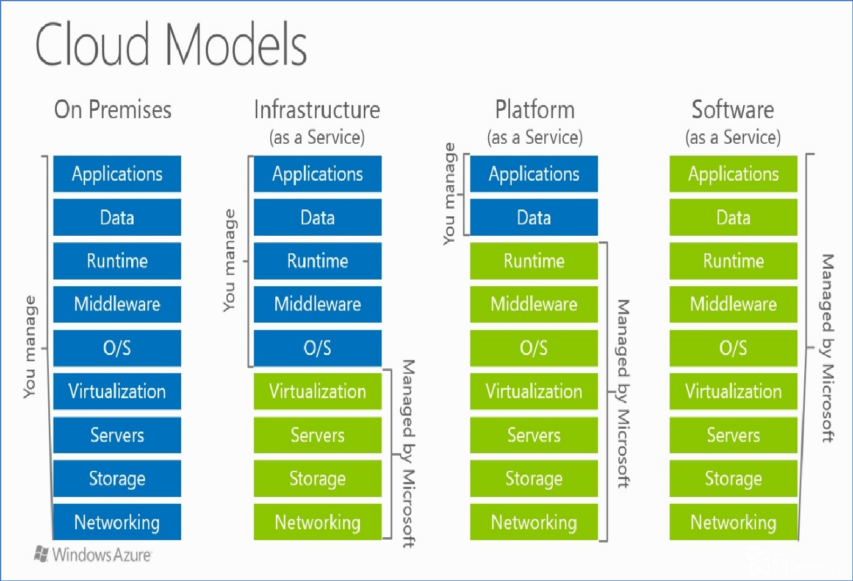

Slide 56
Benefits

